Slide 2
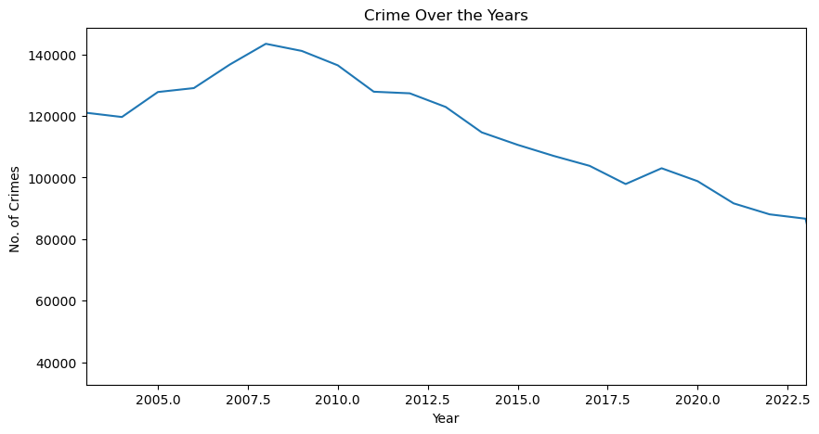
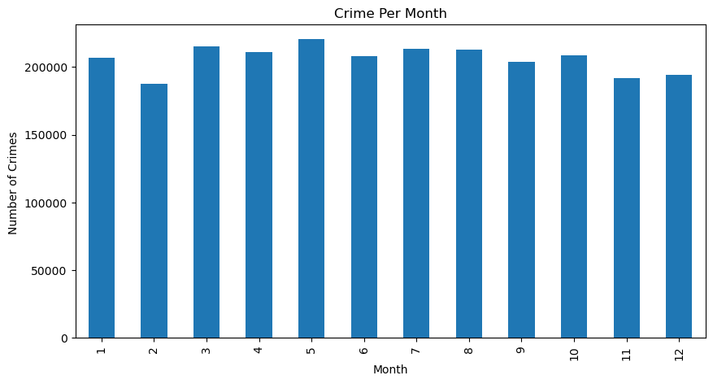
Basic Analysis
Sole curiosity… crime analysis over the years in Austin, TX
From the bare eye, the months look evenly distributed when it comes to crime in general

Slide 3
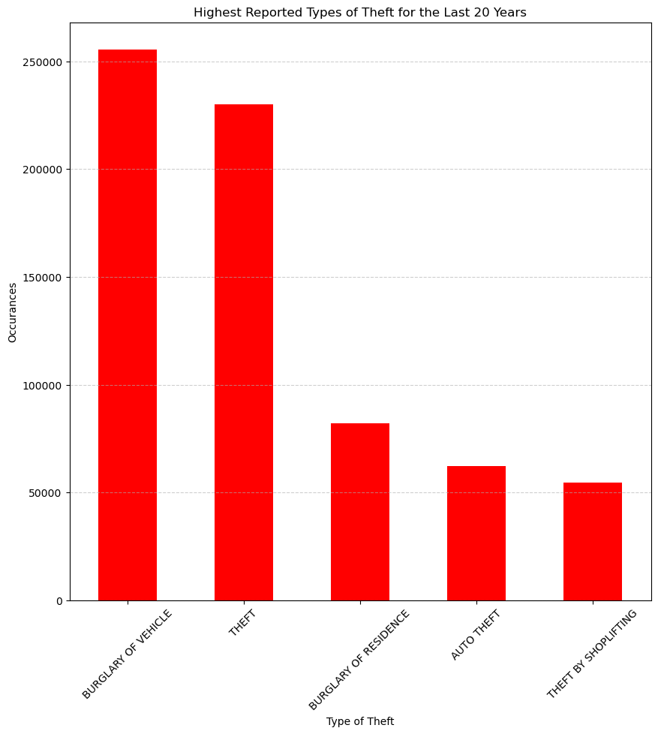
First Step
After reading the csv, I wanted to see which types of theft crimes were reported the most
We know were going to be doing chi square so we do a critical value test
7.814727903251179

Slide 4
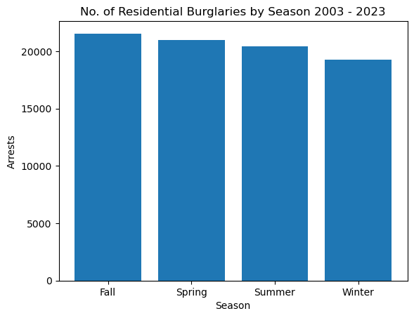
Residential Burglaries by Season
Looks to be less in the Winter
Chi-Square Statistic: 68.10559048133163
p-value: 1.0860061995797653e-14
With a very high chi-square value and a very low p-value this tells us that we can reject the null hypothesis and say
SEASON COULD DEFINITELY BE AFFECTING THE NUMBER OF RESIDENTIAL BURGLARIES

Slide 5
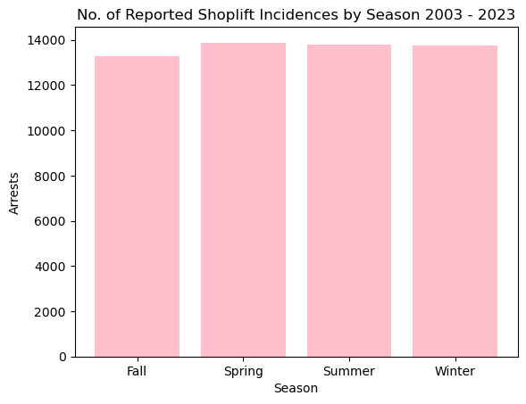
Shoplifting
Pretty even, but maybe less in the fall

Slide 6
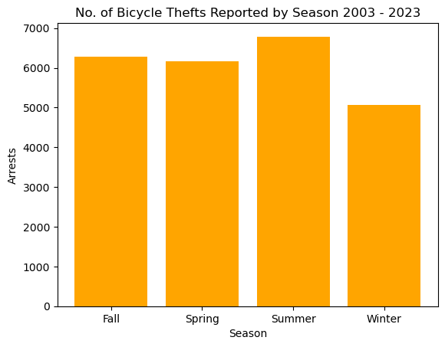
Bicycle Thefts
ALL TIME LOW IN THE WINTER
ALL TIME HIGH IN THE SUMMER

Slide 7
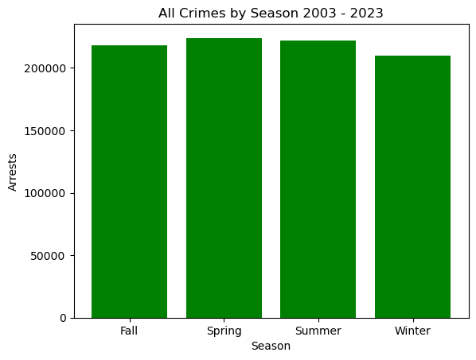
ALL CRIMES BY SEASON CHI SQUARE TEST
Chi-Square Statistic: 280.6044358946858 p-value: 1.566923504984882e-60
REJECT NULL HYPOTHESIS
This means.. Season could be having an impact on crime rate!!

